Slide 1
The Design of HidrateSpark
By: Julia Emery

Slide 2
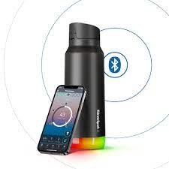
Background Info:
Started in 2014
Wanted to help create healthy lifestyles
Created a water bottle to track ones water intake
Around 26 employees

Slide 3
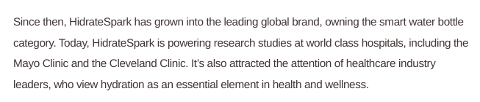
User Base
Targets wide audience
Athletes
Hospitals such as Mayo Clinic and the Cleveland Clinic
Anyone struggling to meet their needed water intake

Slide 4
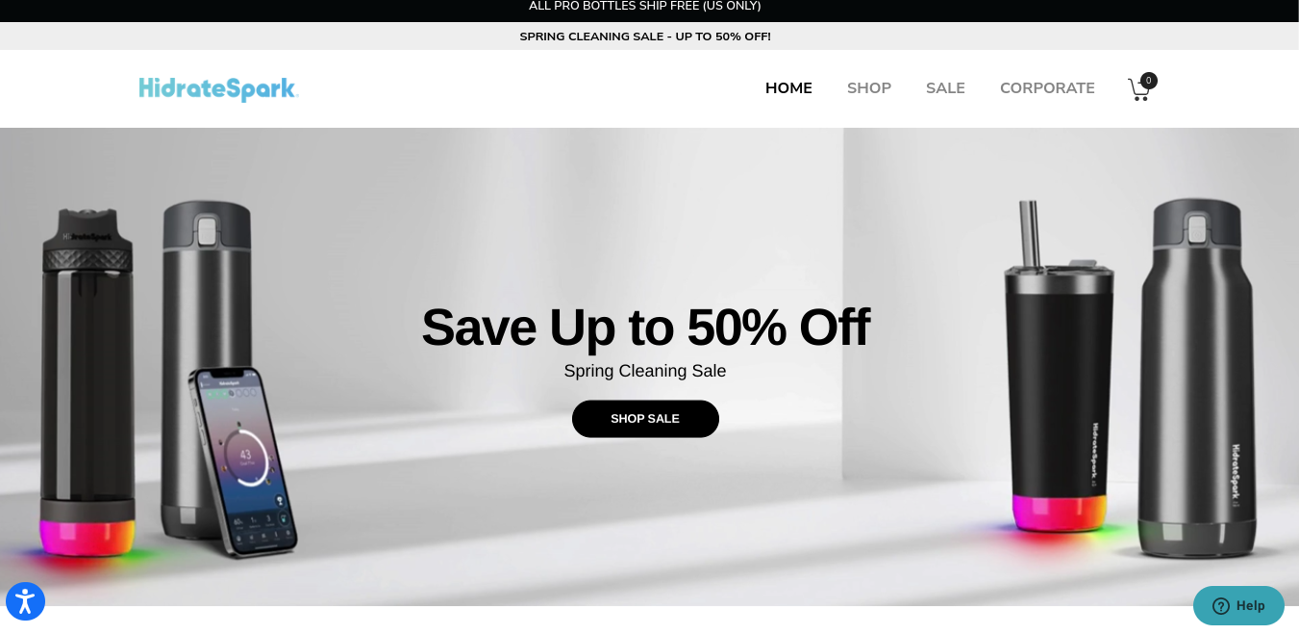
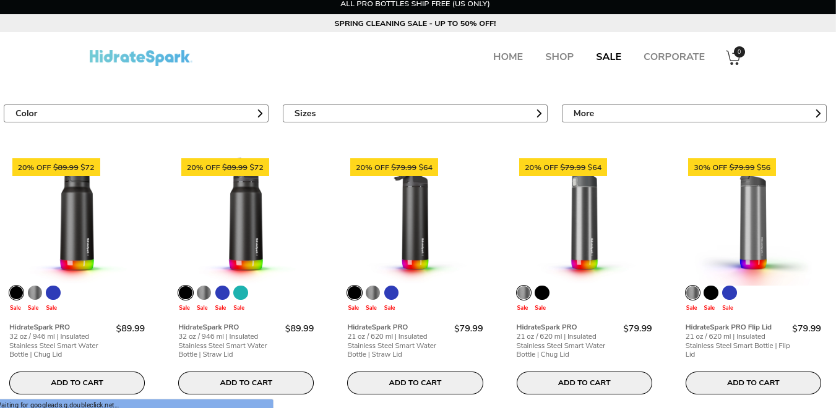
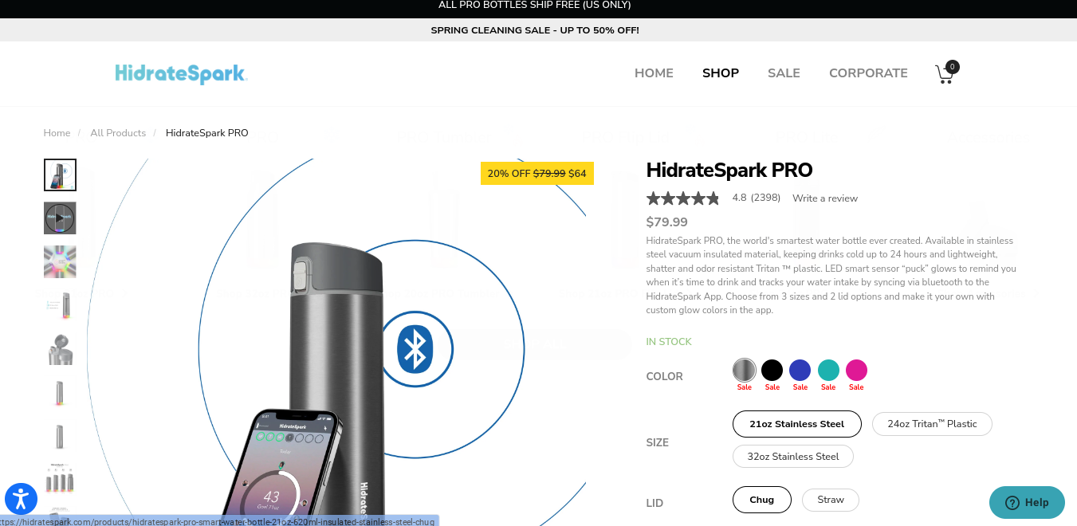
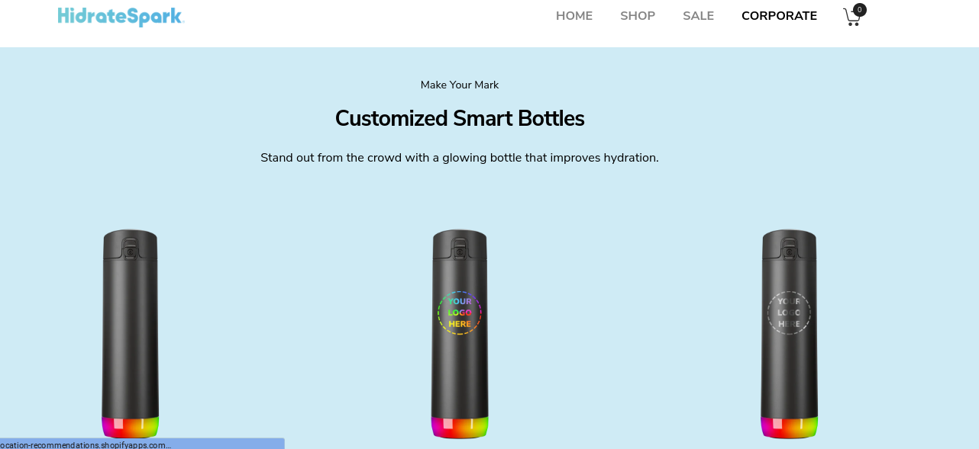
Accessibility Design
4 main pages
Additional pages at the bottom

Slide 5
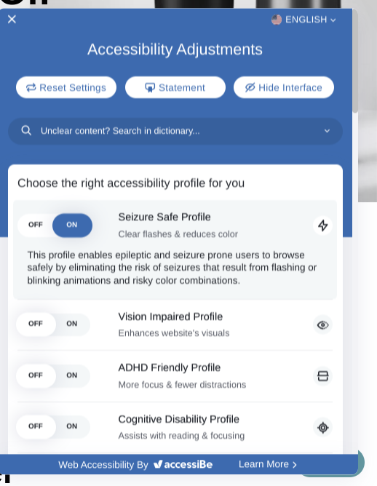
Interactive
Has a help option
Has pop-up adds
Allows you to customize your bottle
Has 16 language options as well as other visual adjustment

Slide 6
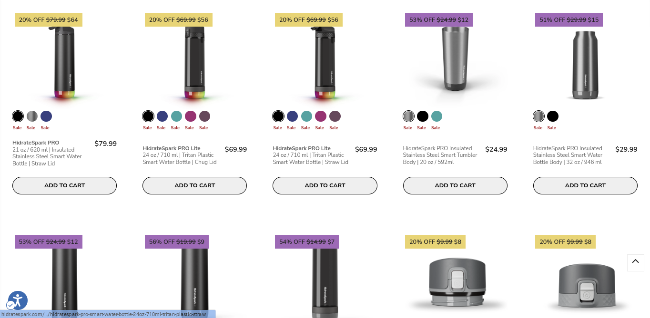
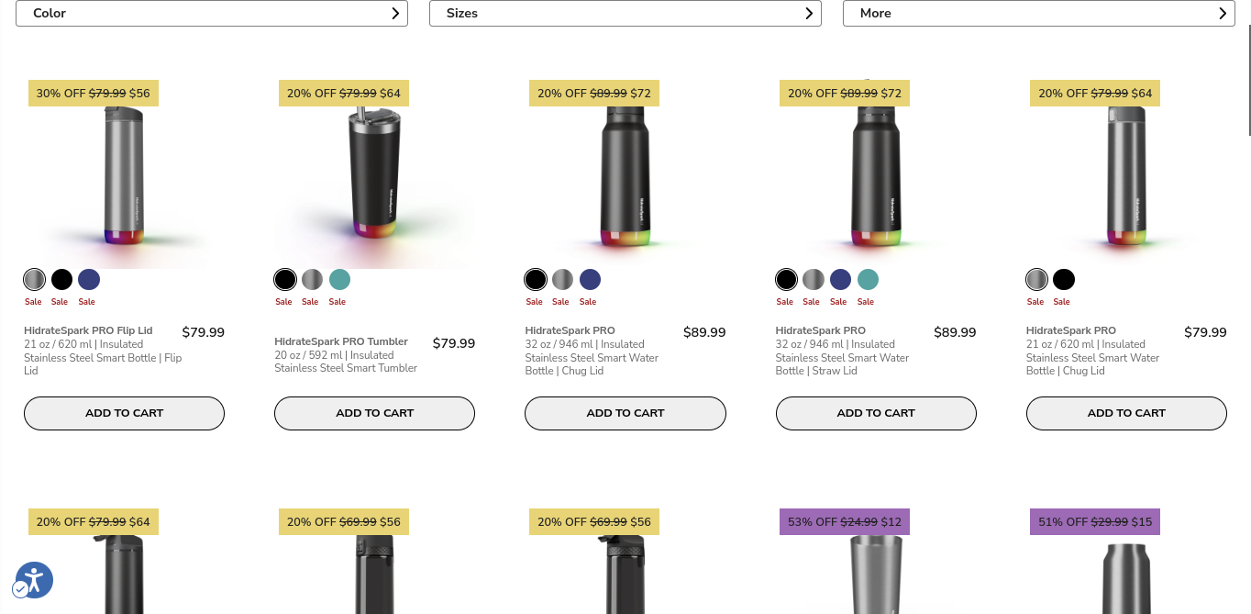
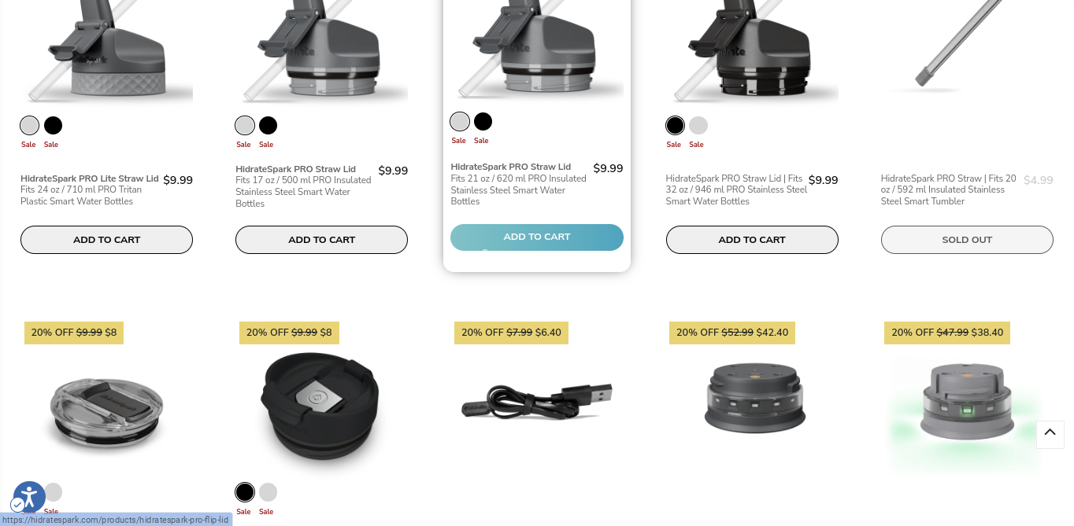
Prices
Prices range from $6-$80

